Slide 1
Welcome to
Governors State University

Slide 2
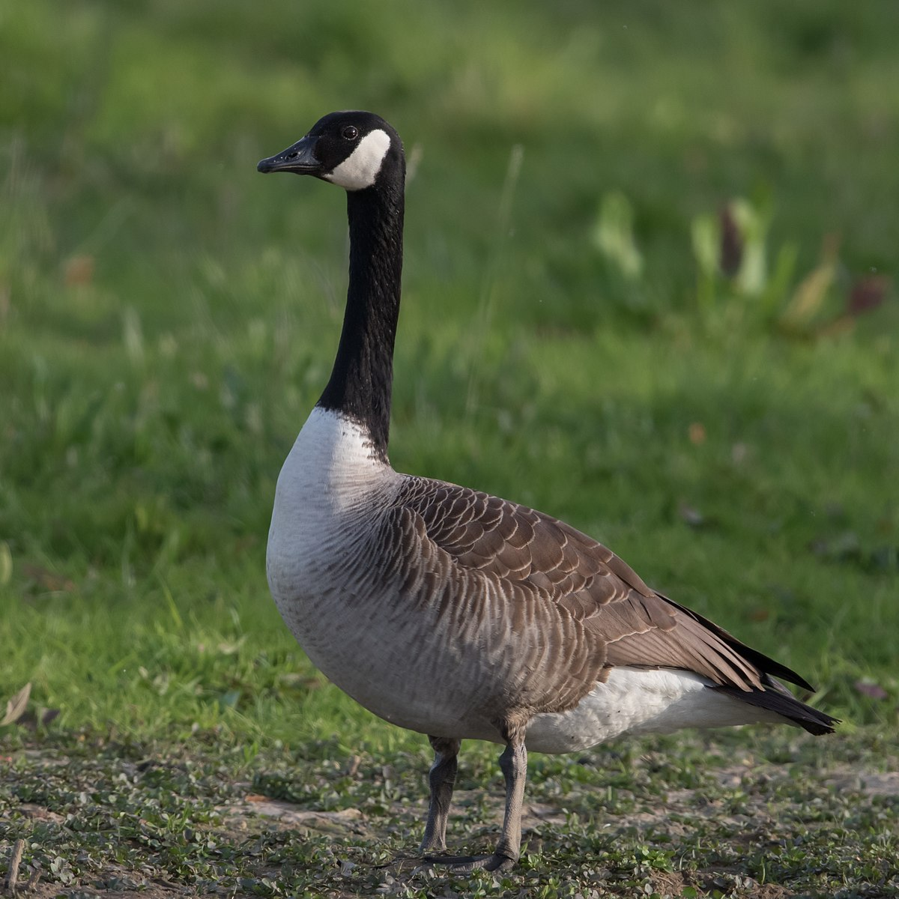
GSU Trivia
How tall is the Paul Bunyan Statue located across from Prairie Place?
25 feet
What is the most commonly seen bird on campus?
Goose
What year did GovState welcome the first class of four-year freshman?
2014

Slide 3
What is Admitted Student Day?
Establish a personal connection with our freshman students with GSU staff
Prepare students for enrollment steps – Today’s Actionable Items
Complete the deposit process
Learn more about Freshman Orientation
Prepare students to apply for housing
Confirm eligible students for the Honors College
Review the financial aid process
Early step in establishing a community and INCREASE STUDENT SUCCESS!

Slide 4
Fast Facts on GSU
62,000+ alumni
750-acre campus
80+ student organizations and clubs
4,338 students enrolled
12:1 student to faculty ratio
24 countries represented
#1 safest campus in Illinois
(www.niche.com/colleges/search/safest-colleges/s/illinois/?type=public)
#8 safest campus in U.S.
(backgroundchecks.org/50-safest-colleges-in-america.html)

Slide 5
Top Undergraduate Majors
Accounting, BS
Nursing, BSN
Communication, BA
Community Health, BHS
Elementary Education, BA;
English, BA;
Information Technology, BS
Interdisciplinary Studies, BA
Psychology, BA
Business Administration, BA
Criminal Justice, BA
Social Work, BSW

Slide 6
Top Graduate Majors
5. Communication Disorders, MHS
Educational Administration, MA
Counseling, MA
Occupational Therapy, MOT
Accounting, MS
Computer Science, MS
Social Work, MSW
Health Administration, MHA
Physical Therapy, DPT

Slide 7
Quality
73% rate overall experience as excellent or good*
101 average pages of assigned writing in the first year*
80% complete high-impact practices*
61.5% of GSU students receive grants and scholarships
International students from over 24 different countries
*National Survey of Student Engagement 2018
Nationally Recognized by US News and World Report
2022 Social Mobility
2022 Online Undergraduate Business Programs
2021 Ethnic Diversity
2021 Student Debt Load at Graduation – Least Debt
2021 Undergraduate Business Programs
2021 Undergraduate Computer Science Programs

Slide 8
What’s New @ GOVSTATE?
First Generation Center – opened in Fall 2023; support center focused on providing extra resources to succeed in their educational journey
Latinx Resource Center - opened in Spring 2024; serving Latinx students by supporting, appreciating and culturally representing on GovState’s campus
Social Justice Initiative (Legal Clinic) – opened Summer 2023; provides free self-help legal assistance and non-legal resources to low-income Illinois residents
Greek Life – Alpha Kappa Alpha Sorority, Incorporated was the first divine nine organization to cross on GovState campus in November 2023; more to come…

Slide 9
First Year Experience

Slide 10
First Year Experience
As a GSU Freshman, you will…
-Declare an area of academic interest
-Be placed in 1 of 7 First Year Focus Areas to complete general education courses
-Work with an academic advisor who will help you develop a full-time schedule structured to ensure you succeed
-Attend classes capped at 30 students
-Learn with academic peers
-Transition into a program that best meets your needs

Slide 11
7 Focus Areas of Study
DISCOVERY
Undecided? You’re not alone! About 1/3 of all Bachelors-level students change majors in the first 3 years. Explore options under guided expertise to save money and time.
EDUCATION
Secondary Education (Biology, Chemistry, Mathematics, English}, Early Childhood Education, Elementary Education
BUSINESS
Business Administration, Entrepreneurship, Health Administration, Accounting
ARTS & ENTERTAINMENT
Fine Arts, Media Studies, Theater and Performance Studies
HUMANITIES
English, History
SOCIAL & BEHAVIORAL SCIENCES
Anthropology, Sociology, Communication, Criminal Justice, Economics, Political Science, Psychology, Social Work
STEM
Biology, Chemistry, Communication Disorders, Community Health, Computer Science, Information Technology, Mathematics, Nursing

Slide 12
First Year Experience
Laptops Provided
Lock-in your tuition rate
Make your $50 Enrollment Deposit today!
-$50 Deposit is applied directly towards your first semester’s tuition bill
-Secures your place in GSU’s LIMITED Freshman class

Slide 13
Jaguar LEAP Summer Immersion Program
Live, Experience, and Prepare
Monday, July 8th - Friday, August 16th
Live: Live-on campus. Meet faculty, staff and peers. Learn campus resources.
Experience: participate in activities on campus and in downtown Chicago
CPA
The Nate
Biological Field Station
Athletics and Recreation Center
Center for Community Media
Prepare: During Jaguar LEAP, you’ll earn seven college credits, giving you a jumpstart on your first year.
Mastering College: Navigating Higher Education (1 credit)
First Year Seminar: Interdisciplinary Humanities (3 credits)
Social and Behavioral Science: General Education Course (3 credits)
Application available now: https://www.govst.edu/jaguar-leap/

Slide 14
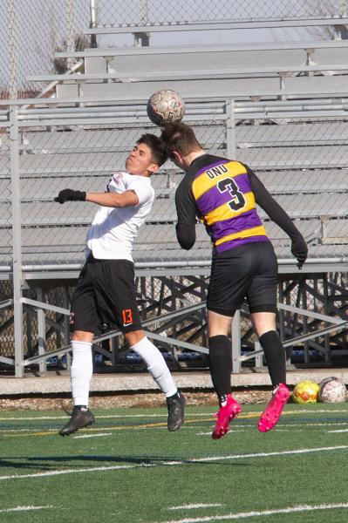
Become a Jaguar!
NAIA Collegiate Teams
-Men’s and Women’s Basketball
-Men’s and Women’s Cross Country & Track (New for FA23)
-Men’s and Women’s Golf
-Men’s and Women’s Soccer
-Women’s Volleyball
-Women’s Bowling (New for FA23)
Varsity Reserve Teams:
-Men’s and Women’s Basketball
-Men’s and Women’s Soccer
-Women’s Volleyball

Slide 15
Get Involved!
Accounting, Finance, and Economics Club
Allied Health Professional Society – Alpha Eta
Alpha Iota Sigma
American Advertising Federation – GSU Chapter
American Sign Language Club
Art Forum
Association of Latin American Students
Beta Gamma Sigma, Honor Society
Black Student Union
Chess Club
Chi Sigma Iota, Honor Society
Chinese Student Association
Coalition of Occupational Therapy Advocates for Diversity
Computer Technology Club
Criminal Justice Club
Gender and Sexuality Club (GNSX)
Generating Hope
Graduate Professional Network (GPN)
GSU Bowling Club
GSU Cheer Squad
GSU Dance Company
GSU Honors Program Student Council
GSU ICA Chapter
GSU Psychology Club
GSU Supply Chain Student Club
International Business Club
International Culture Organization
Jaguars Gaming Club
Kaleidoscope
Kappa Delta Pi, Honor Society
Lambda Pi Eta-Kappa Kappa Chapter
Ladies of Virtue and Excellence (L.O.V.E)
Male Success Initiative
Master of Public Administration Club
Muslim Students’ Association
Peer Mentor Program
Phi Alpha, Honor Society
Phoenix Newspaper
Physical Therapy Student Association
Pre-Health Club
Psi Chi Psychology National Honors Society
Reconstructed
Sigma Tau Delta – Alpha Chi Psi Chapter
Soccer Club
Social Work Student Organization
Student Activities Council
Student Education Association
Student Healthcare Management Assoc.
Student Occupational Therapy Assoc.
Student Senate
Student Veterans Organization
Students of Addiction Studies Club
Sustainability Club
Table Tennis Club
Tau Sigma National, Honor Society
Trans4mation Gospel Choir
Upsilon Phi Delta, Honor Society
Wellness Club
Writers Union
Young Christian Disciples
…and you can always start a new club!

Slide 16
Crawford Honors College Experience

Slide 17
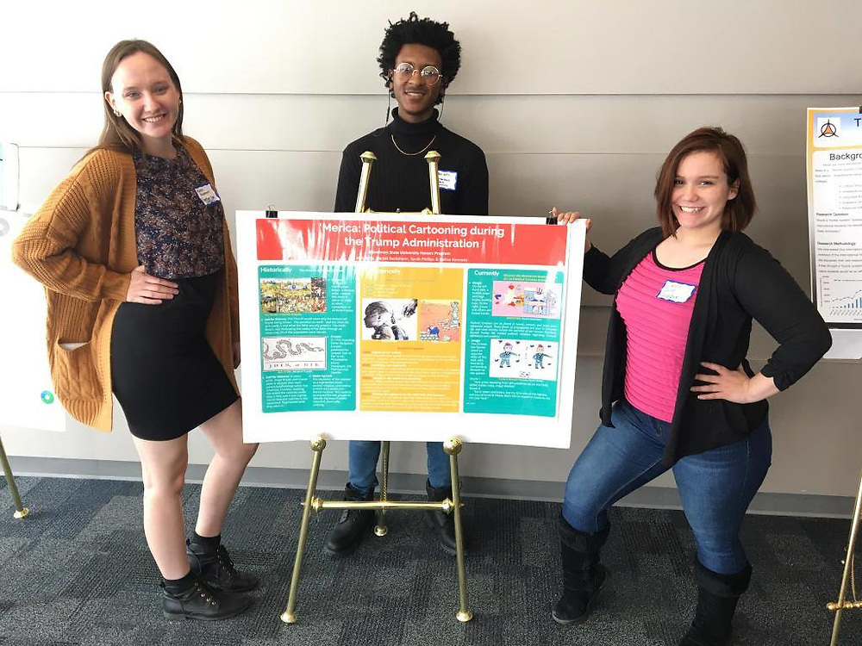
What is different about
University Honors?
Innovation
Leadership
Creating Initiatives
Community Building

Slide 18
GPATH - Guaranteed Graduate
Admissions Pathway
Start as a freshmen honors student
Finish first semester with 3.5+ GSU GPA
Second semester receive an invite to join GPATH
Retention standards apply each semester
Can still apply to GSU grad school programs through normal means if GPATH spot not retained

Slide 19
GPATH - Guaranteed Graduate
Admissions Pathway
Student gains faculty and track adviser in one of ten graduate programs.
Business – All Grad Programs (4)
Health & Human Services – OT, PT, CDIS, Informatics
Arts & Sci – Biology, Chemistry
Support for career planning, course planning, grad school readiness

Slide 20
Guaranteed Graduate Program Admission (GPATH)
Guarantees admission into one of ten graduate programs after graduation with your bachelor’s degree
Accounting
Biology
Business Administration
Business Analytics
Chemistry
Communication Disorders
Health Informatics
Human Resources
Occupational Therapy
Physical Therapy

Slide 21
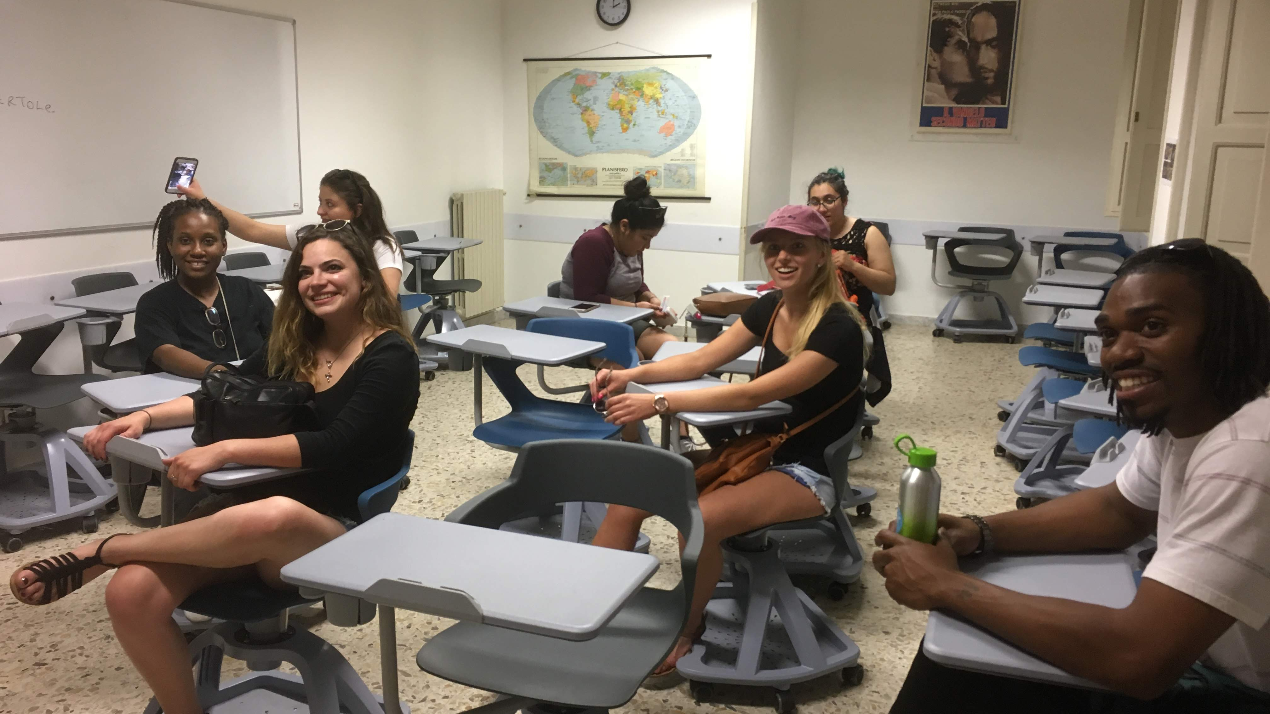
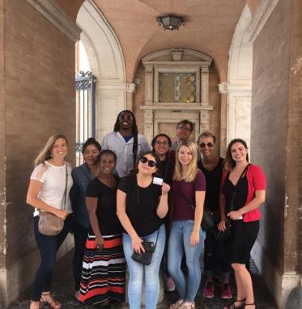
Honors Study Abroad in Rome, Italy

Slide 22
Contact Information
Dr. David Rhea, PhD
Interim Dean, Crawford Honors College
drhea@govst.edu

Slide 23
Financing
Your Education

Slide 24
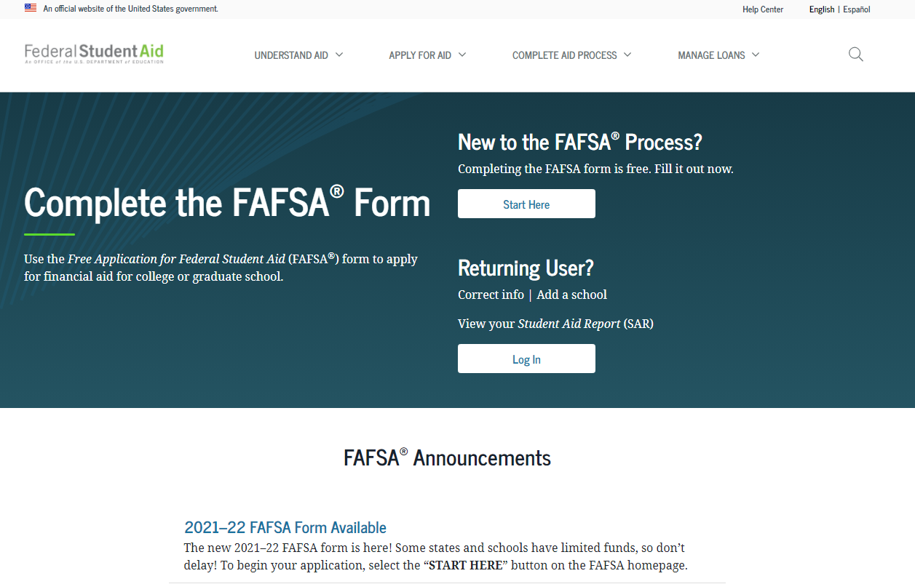
How do I apply for Financial Aid?
Starts with the #FAFSA!
(Free Application for Federal Student Aid)

Slide 25
Types of Financial Aid
1. Grants
2. Loans
3. Scholarships
4. Student Employment Opportunities

Slide 26
Grants
Federal PELL Grant
Illinois MAP Grant
Federal SEOG Grant
TEACH Grant

Slide 27
Student Loans
Federal Direct Loan
-Subsidized
-Unsubsidized
-PLUS
Private Student Loans

Slide 28
Scholarships
GSU Scholarship homepage: www.govst.edu/Scholarships/
Scholarship Universe: govst.scholarshipuniverse.com/public
With Scholarship Universe, Students will be able to:
• Answer questions and match to scholarship opportunities they are eligible for
• Easily apply online to multiple scholarship opportunities through a personalized portal
• See scholarship metrics to determine their chances and effort required to apply
• Be alerted whenever they are matched to new scholarship opportunities
• Receive automated reminders about outstanding tasks and next steps

Slide 29
Federal Work Study
Employment on or off campus
Minimum wage or higher
Gain valuable work experience
Work up to 30 hours per pay period

Slide 30
AIM HIGH – First Year Students
HIGH SCHOOL | Fall 2024 / Spring 2025
TIER 1
GPA | 3.5+
Award Amount | $5000 per year
TIER 2
GPA | 2.75 to 3.49
Award Amount | $3000 per year
GPA Threshold
Scholarship
HS GPA: 3.5 – 4.0 $5,000 annually
HS GPA: 3.0 – 3.49 $3,000 annually
Notes:
*Students must complete AIM HIGH Confirmation form as well as submit $50 enrollment deposit to secure scholarship

Slide 31
AIM HIGH Criteria
To qualify for AIM HIGH, students must:
Have attended an Illinois high school.
Be enrolled full time in a baccalaureate degree program at Governors State University for the first time.
Be a resident of Illinois.
Be a U.S. Citizen or eligible non-citizen.
Not have household income that exceeds eight times the poverty rate.
Meet full admissions criteria.
Not yet have earned a baccalaureate degree or 135 undergraduate credit hours.
Not be in default of student loans or owe a refund or repayment of state or federal grants or scholarships
Scholarship

Slide 32
AIM HIGH RETENTION
To remain qualified after the first year, you must:
Continuously enroll as a full-time student (at least 12 credit hours) at GSU for Fall and Spring semesters.
Maintain Financial Aid Satisfactory Academic Progress (SAP) as outlined by the SAP Policy.
Maintain a cumulative 2.5 institutional grade point average at GSU.
Submit the FAFSA or Alternative Application for Illinois Financial Aid each year you are enrolled at GSU.

Slide 33
Tuition and Fees
 | GSU Cost | Financial Aid Opportunities
Non- Residential Cost | $14,056 per year* ($56,224 Degree) | Max Pell Grant: $7,395 Max Illinois MAP Grant: $8,400 Potential Refund of $2,099 (Fall and Spring Combined)
Residential Cost (Tuition, fees, housing, and meal plan) | $22,160 ($88,640 Degree) | Remaining Cost: $6,100*

Slide 34
Office of Financial Aid
Phone: (708) 534-4480
Email: faid@govst.edu
Website: www.govst.edu/financialaid/

Slide 35
Housing and
Dining at GSU

Slide 36
Living on Campus
Designed to accommodate students of all class levels – first year through graduate students
Easy access to variety of campus resources – faculty, advisors, library, computer lab, rec center, bookstore, student organizations
Opportunity to take on leadership roles in your community
Develop relationships with a diverse population of people
Able to participate in late night study groups and fully participate in activities on campus
Create memories that will last a lifetime and meet people, many who will be friends for life

Slide 37
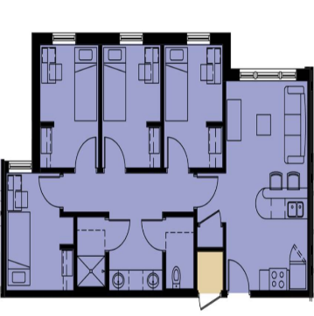
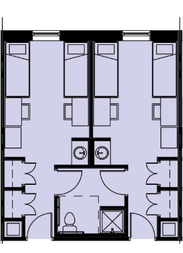
Unit Types in Prairie Place
Semi-Suite – share bedroom; bathroom connected to next room
4 bedroom apartment
(single bedroom)
$10,154/annually
$7,104/annually

Slide 38
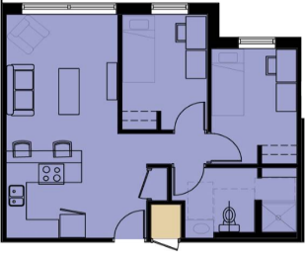
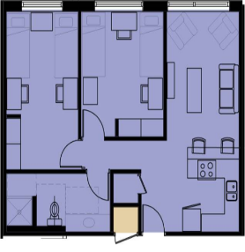
Unit Types in Prairie Place
2 bedroom apartment
(single bedroom) LIMITED availability
2 bedroom apartment – share bedroom with roommate, 4 people in total
$8,360/annually
$12,046/annually

Slide 39
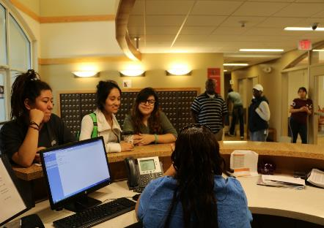
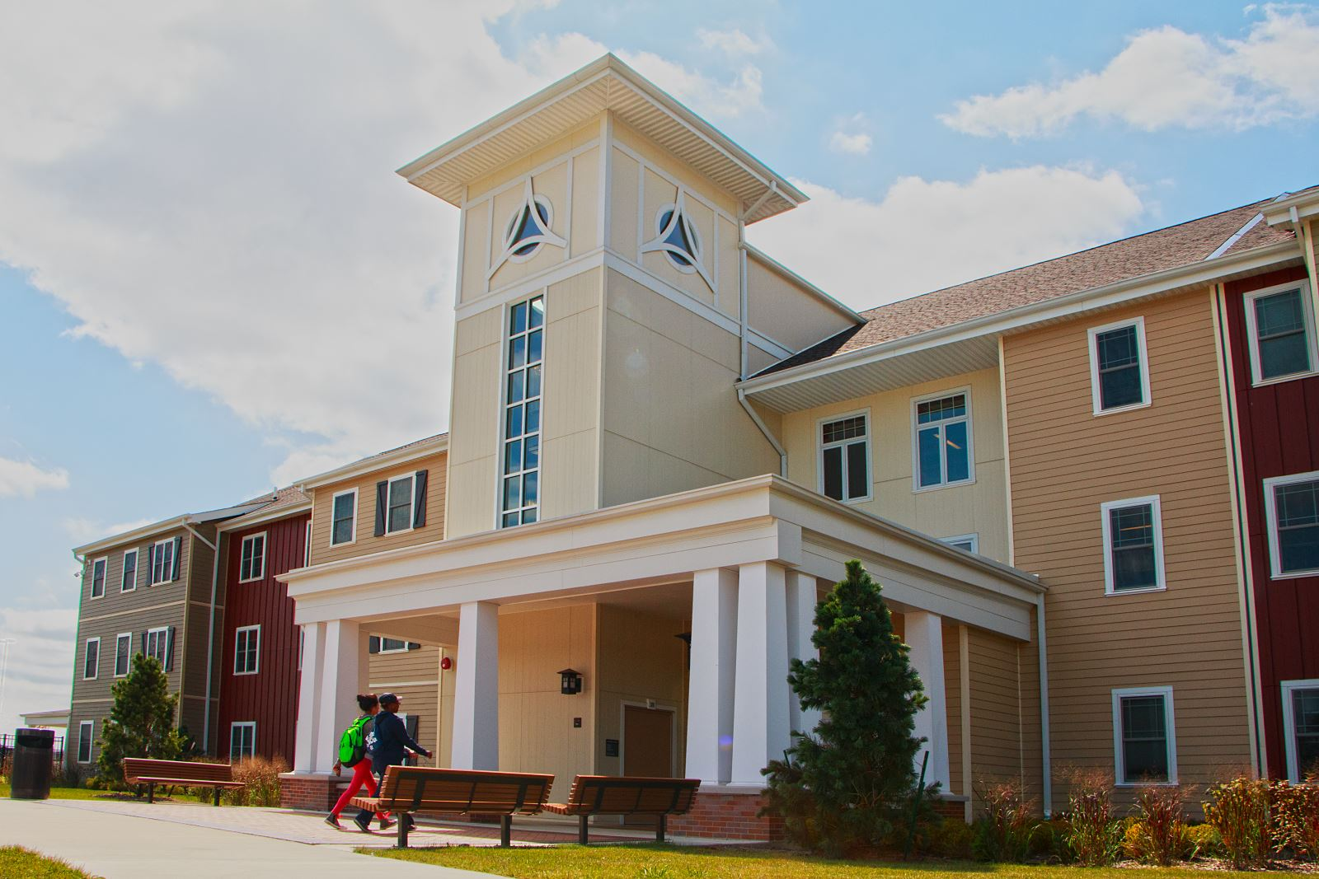
Staffing
Trained Resident Assistants
Residence Hall Director
Asst. Residence Hall Director
2 Faculty-in-Residence
Mental Health Counselor (new)
24 hour front desk coverage
(Student Workers / Community Service Officers)

Slide 40
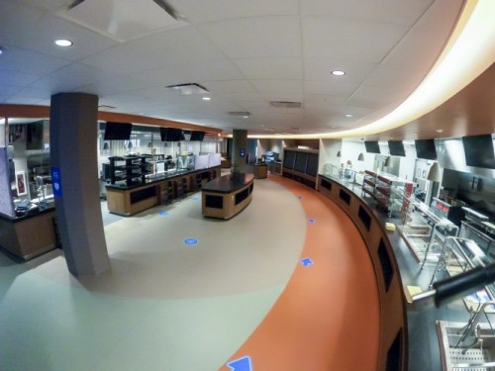
Campus Dining
Convenient & Flexible Plan
Use in Café or C-Store
Choose the plan that works for you:
Gold Plan $1,500 / semester
Silver Plan $1,000 / semester
Bronze Plan $500 / semester
*If you are a Prairie Place resident, you will be assigned a Meal Plan according to your housing room type*

Slide 41
Applying for Housing
Please check your student email for updates for FA24.
Apply online at: www.govst.edu/housing
Email: housing@govst.edu
Phone: (708) 235-7110

Slide 42
Admitted Freshman Checklist

Slide 43
Admitted Freshman Checklist
Get started on your journey as a Jaguar by activating your myGSU portal: You can find your login information on your admission acceptance letter.
Complete the Free Application for Federal Student Aid (FAFSA): at www.FAFSA.gov to qualify for all types of financial aid. Use GSU’s school code—009145—to make sure we receive your financial aid information.
Complete Placement Exams: Students in STEM majors need to complete placement before attending orientation.
Complete Freshman Orientation: Your journey as a GSU student begins with Freshman Orientation! We have transitioned to an in-person or online format– access through the myGSU portal.
Submit your Immunization records via MedProctor. www.medproctor.com by the start of your first semester or when you move into on-campus housing.
Submit the Freshman Enrollment Deposit: Submit your deposit today!

Slide 44
Accessing myGSU
Step 1: Go to the main webpage: www.govst.edu
Step 2: Navigate to the myGSU Student Portal.

Slide 45
Accessing myGSU
Step 3: Refer to your Admission acceptance letter where you can find your GSU credentials.
Step 4: Enter your student credentials

Slide 46
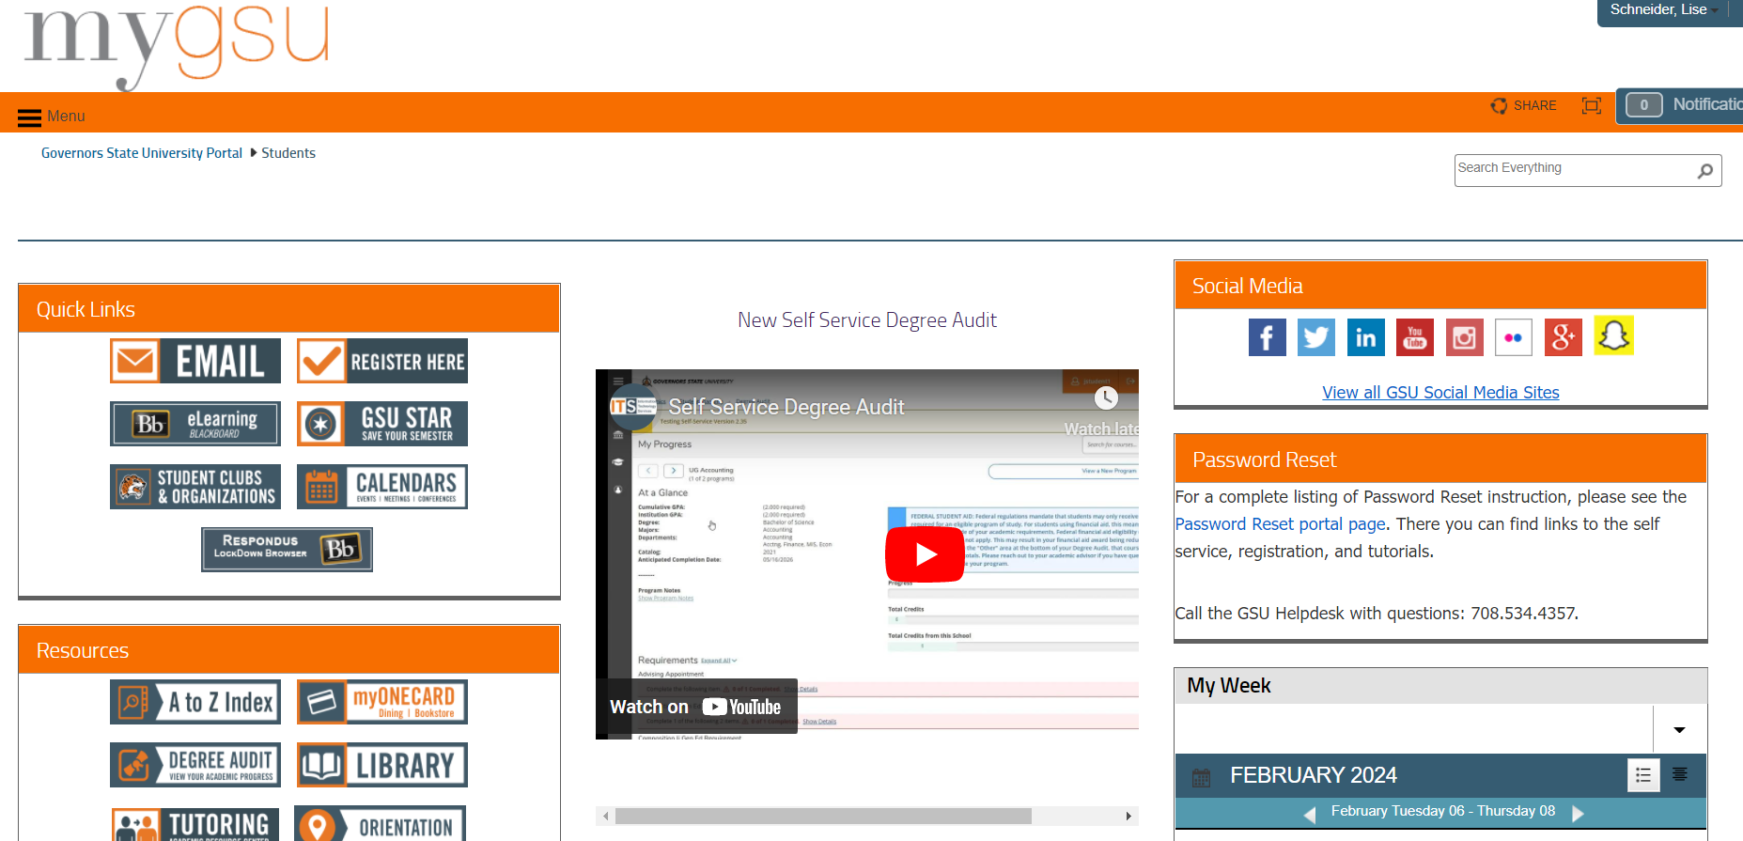

Slide 47
Accessing Financial Aid
Step 1: Navigate to the myGSU Student Portal.

Slide 48
Accessing Financial Aid
Step 2: Log-in with your credentials, which can be found on your Acceptance Letter.

Slide 49
Accessing Financial Aid
Step 3: Under the Online Services, go to the Students tab. Click on Financial Aid then My Financial Aid to see your award amounts.

Slide 50
Award Letter Example

Slide 51
Submitting Immunizations
Step 1: Go to MedProctor website at www.medproctor.com.

Slide 52
Submitting Immunizations
Step 2: Click “register” and create an account using your GSU student email address.

Slide 53
Submitting Immunizations
Step 3: Complete your MedProctor Profile.

Slide 54
Submitting Immunizations
Step 4: Download and Print the Immunization Certificate.

Slide 55
Submitting Immunizations
Step 5: Take the Immunization Certificate form to your medical provider for completion.

Slide 56
Submitting Immunizations
Step 6: Upload your Immunization Certificate Form to MedProctor.

Slide 57
Submitting Immunizations
NOTE: Immunization Record Compliance Deadlines:
Students admitted Fall: September 1
Students admitted Spring: February 1
Students admitted Summer: July 1
For more information about Immunizations, please visit www.govst.edu/immunizations or watch the tutorial video.

Slide 58
Placement Testing
Student in STEM, Business and Education focus areas need to complete placement ahead of attending ROAR orientation.
Registration is online at www.aleks.com or in our Testing Center.
Placement score requirements will be listed in the catalog.
More information to follow!

Slide 59
Freshman Enrollment Deposit
$50 Freshman Enrollment Deposit
Credited to your student account – pre-payment on first semester’s tuition
Saves your seat in Governors State’s limited Freshman Class

Slide 60
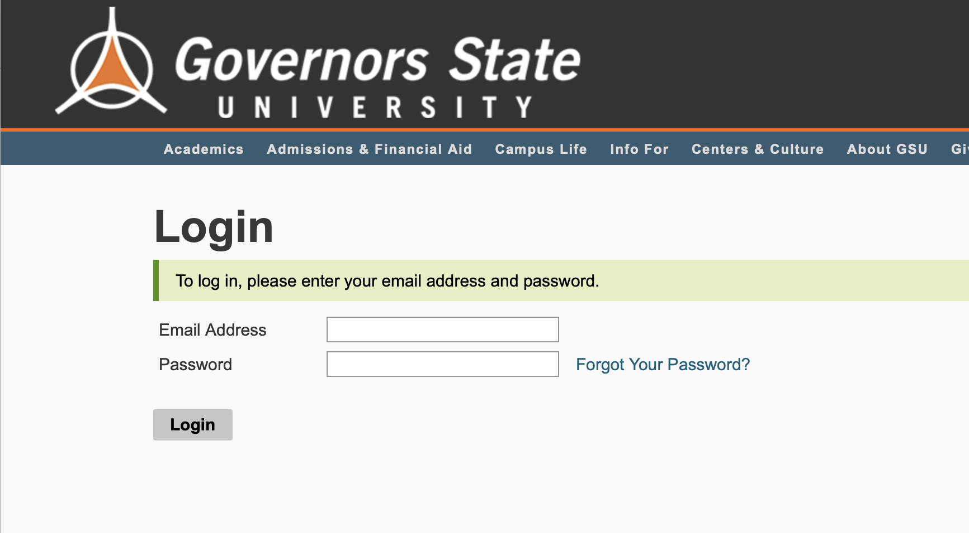
How to Deposit
Step 1: Student can now deposit in the Application Portal
apply.govst.edu/apply/status

Slide 61
How to Deposit
Step 2: Under Status Update, you will see ‘Submit Payment for 50.00 USD’

Slide 62
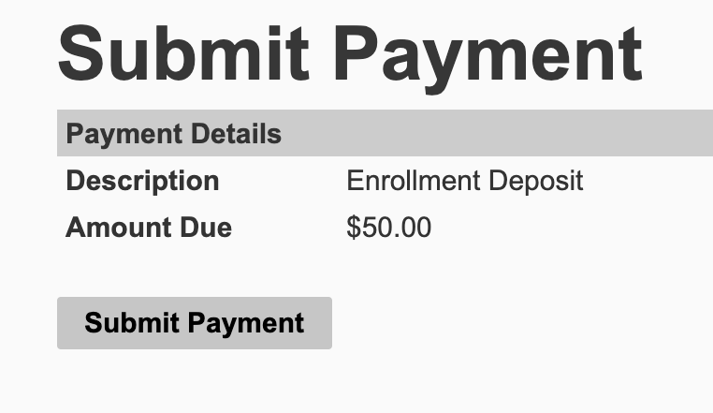
How to Deposit
Step 3: You will receive a screen that reads ‘Submit Payment’, click the button to continue

Slide 63
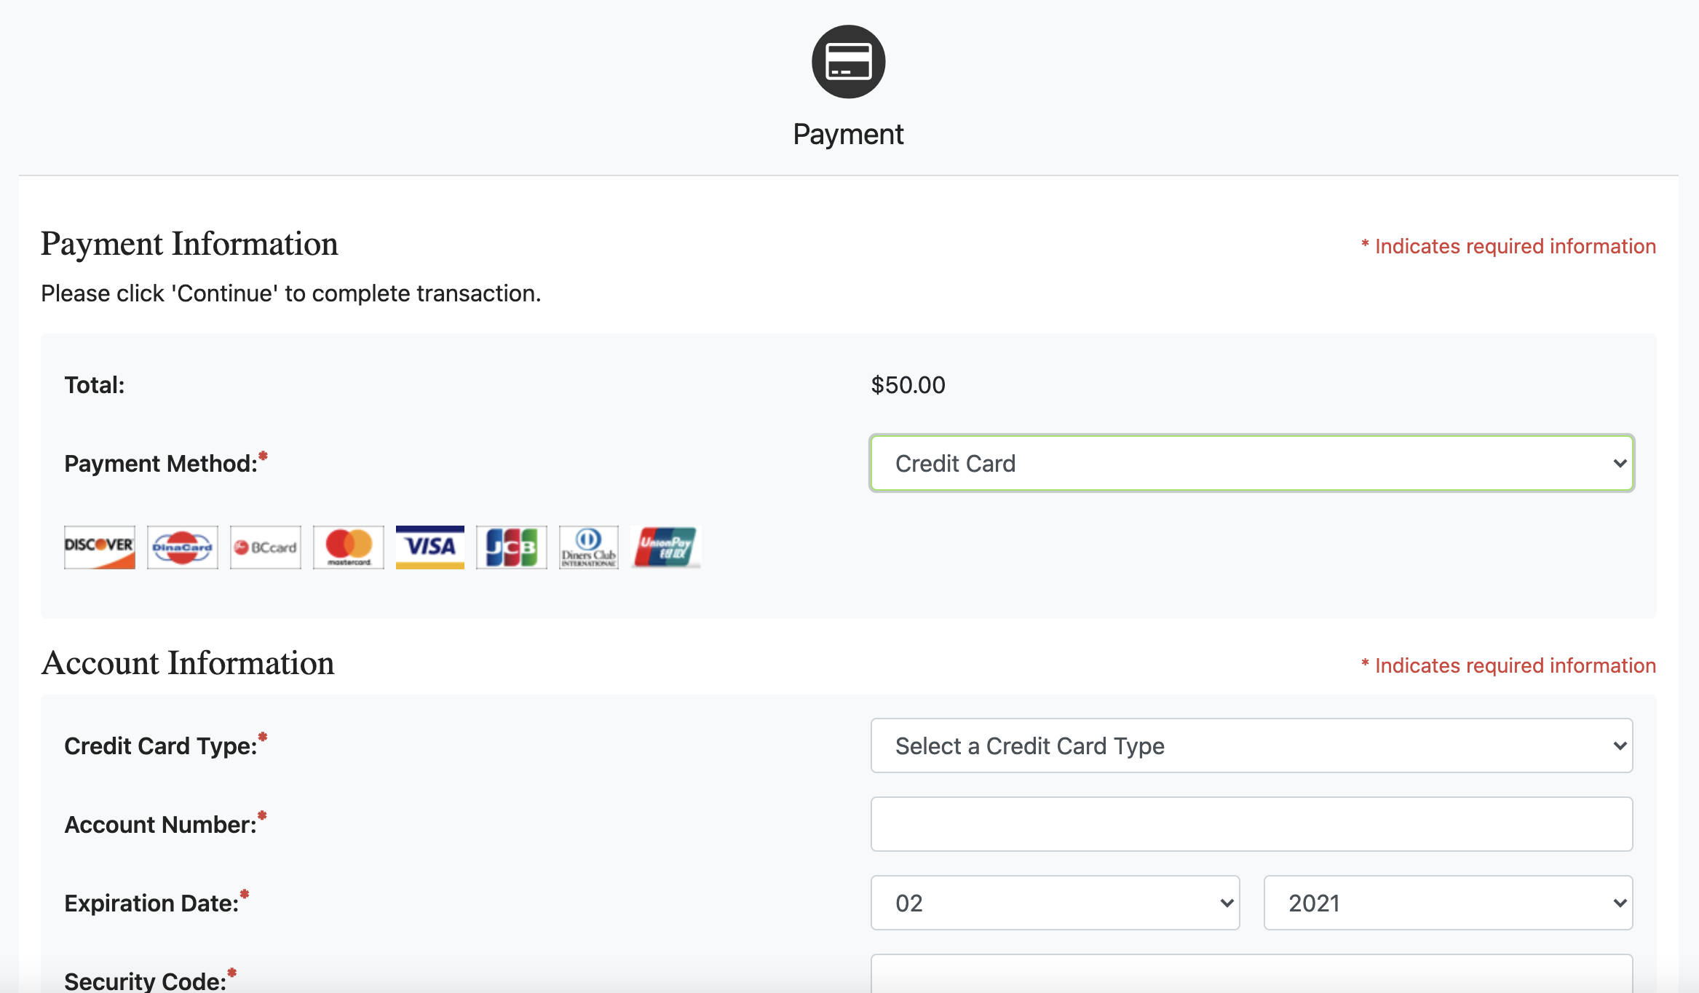
How to Deposit
Step 4: You will be logged into the secure TouchNet Payment Center to submit your Enrollment Deposit

Slide 64
Admitted Freshman Checklist
Get started on your journey as a Jaguar by activating your myGSU portal: You can find your login information on your admission acceptance letter.
Complete the Free Application for Federal Student Aid (FAFSA): at www.FAFSA.gov to qualify for all types of financial aid. Use GSU’s school code—009145—to make sure we receive your financial aid information.
Complete Placement Exams: Students in STEM majors need to complete placement before attending orientation.
Complete Freshman Orientation: Your journey as a GSU student begins with Freshman Orientation! We have transitioned to an in-person or online format– access through the myGSU portal.
Submit your Immunization records via MedProctor. www.medproctor.com by the start of your first semester or when you move into on-campus housing.
Submit the Freshman Enrollment Deposit: Submit your deposit today!

Slide 65
Questions?

Slide 66
Thank You!
body

